Slide 1
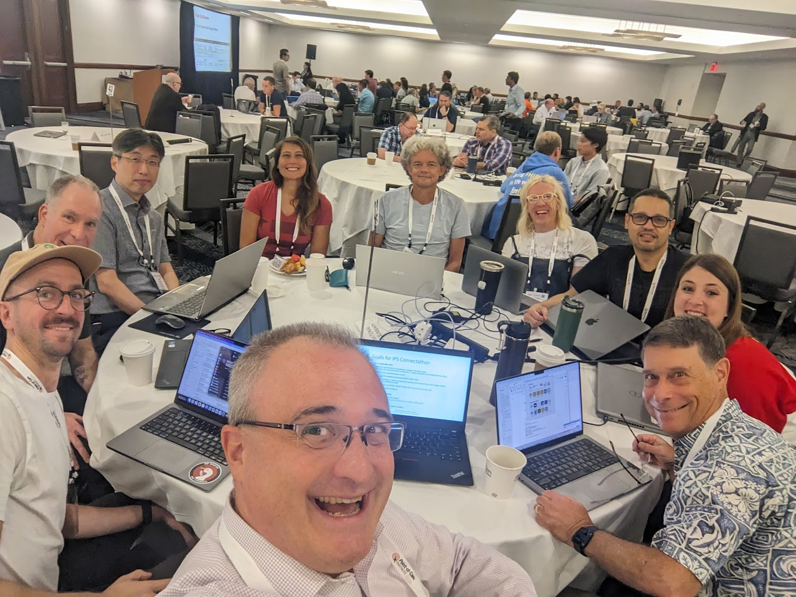
International Patient Summary (IPS)
IPS Structure and Value
John D’Amore, MS
@ HL7 Global Passport Series

Slide 2
Agenda
A Brief Introduction to the IPS
Why a Patient Summary, Why Now?
What’s Upcoming for IPS?

Slide 3
A Brief Introduction to the IPS

Slide 4
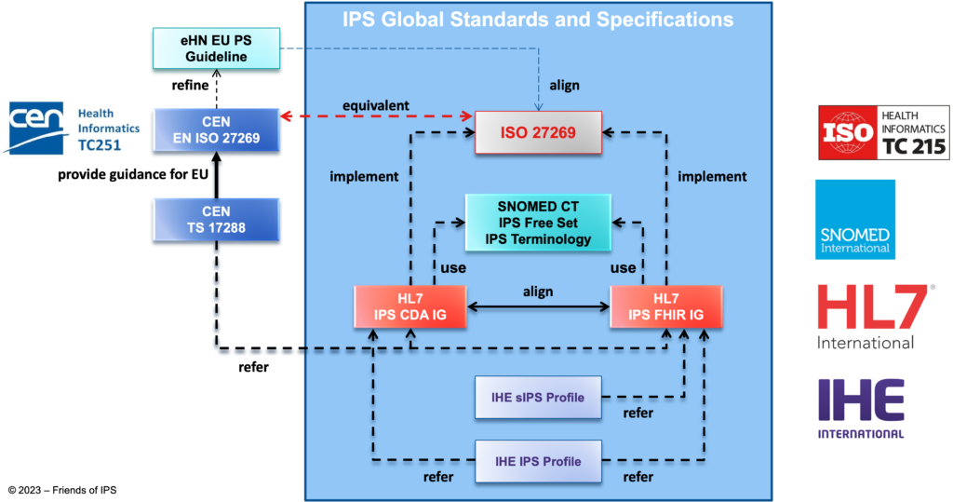
Cross-SDO Collaboration

Slide 5
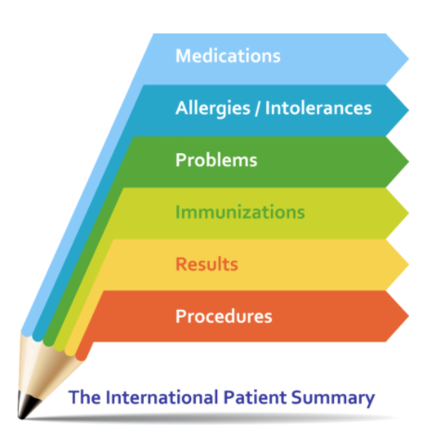
What is the IPS?
A standardized set of basic clinical data
Includes most important health and care related facts
A summarized version of a patient’s clinical data provides health professionals the essential information needed for care
The International Patient Summary is a minimal and non-exhaustive set of basic clinical data of a patient, specialty-agnostic, condition-independent, but readily usable by all clinicians for the unscheduled (cross-border) patient care.

Slide 6


What is the IPS?
Continuity
of Care
&
Cross-Border
National
Provincial
State/Regional
Local
Organizational

Slide 7
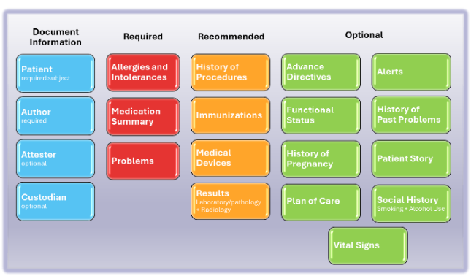
IPS as FHIR Document
The IPS is a Bundle which uses the Composition resource to organize the patient’s summary. It’s both machine readable and human renderable
Bundle
Composition (1)
Patient (1)
Practitioner (*)
Organization (*)
AllergyIntolerance (*)
MedicationRequest(*)
MedicationStatement(*)
Condition (*)
Immunization (*)
Observation (*)
Other Resources (*)
Composition
Elements that describe
document (id, language, text)
Subject of the IPS
Author of the IPS
Clinical Services of IPS
Sections of the IPS
Narrative Text
Resource References

Slide 8
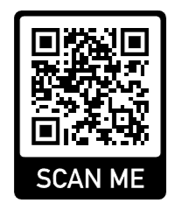
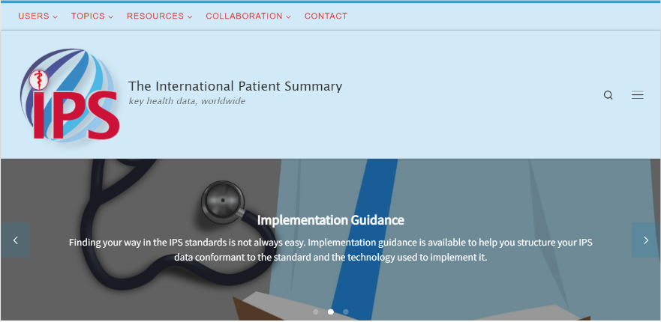
Want a Broader Introduction?
https://international-patient-summary.net/

Slide 9
Why a Patient Summary, Why Now?

Slide 10
IPS in Context of Global Document Exchange
CDA EPS
(EU Specific)
C-CDA 2.1
(US Realm)
Rest of World
Some CDA
Lots of PDF/Fax/Paper
Limited FHIR Documents (before 2024)

Slide 11
Value of the IPS
Provides international format (“universal realm”) baseline with region-agnostic terminologies
Empowers patient and provider-mediated exchange
Leverages global FHIR investments
Domestic adaptation possible for local needs
Support from major technology vendors
Builds on documented benefits of interoperability
https://digitalhealthcanada.com/wp-content/uploads/2022/06/Value-of-the-IPS-in-Canada-v11-03-2021.pdf

Slide 12
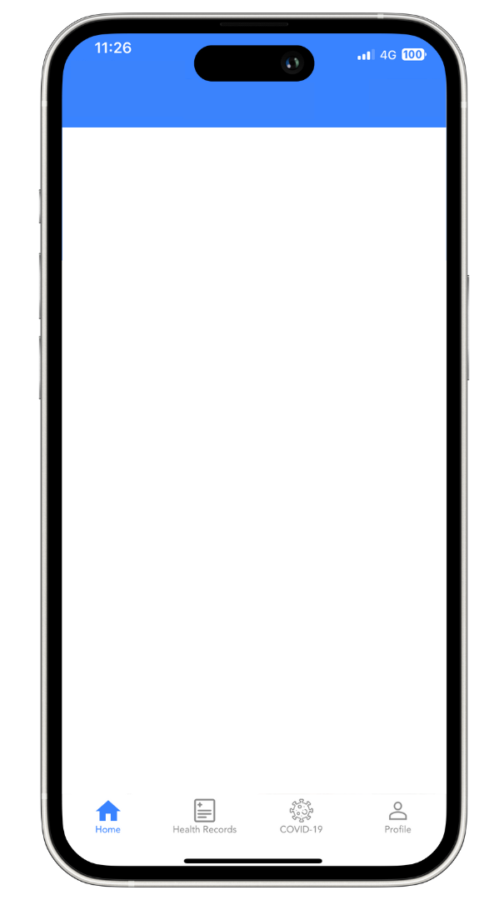
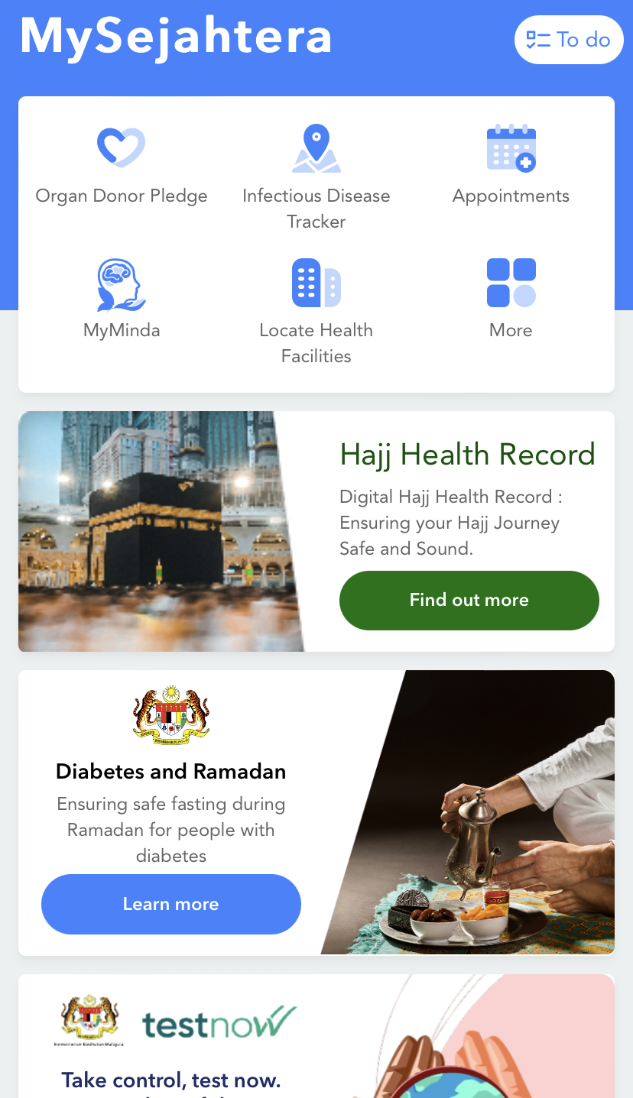
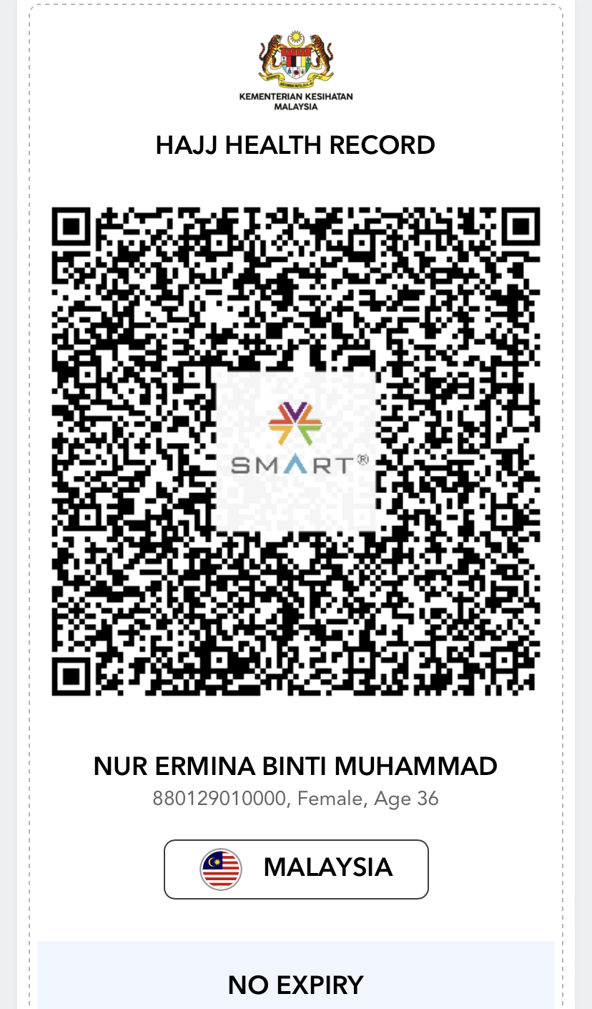
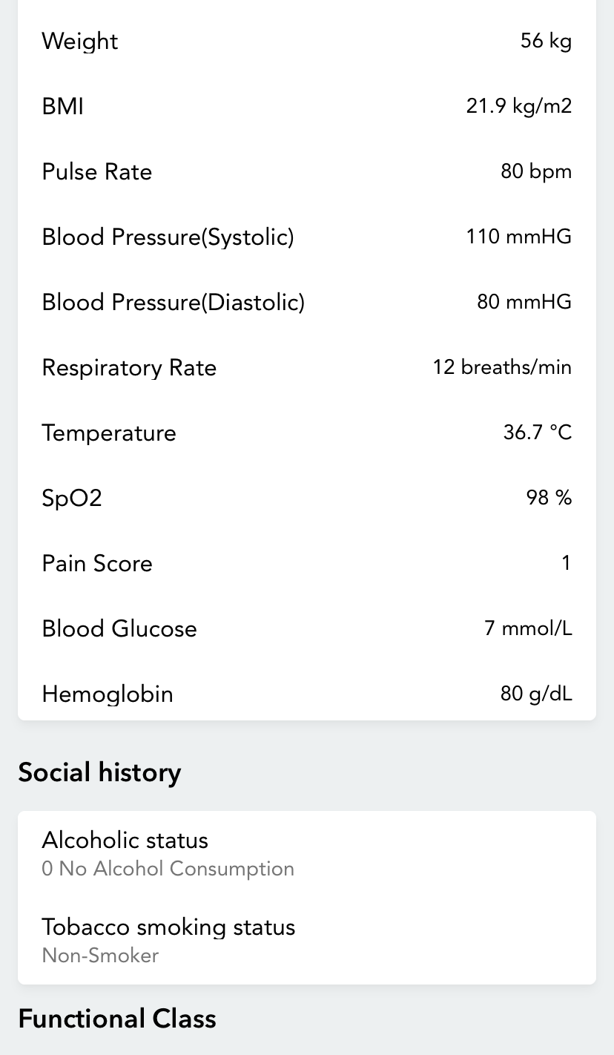
2024 Proof Points
IPS issued for 200,000+ Hajj pilgrims (image right)
Canada launches IPS in two provinces (New Brunswick & Alberta)
Brazil publishes IPS plan
ePatientDave @ HIMSS 24
Major vendors launch (or announce) IPS support
Hajj Health Record
Hajj Health Record
Example from Malaysia’s MySejahtera application

Slide 13
What’s Upcoming for IPS?

Slide 14
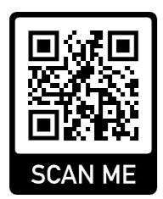
Upcoming for IPS
Publish 2.0 IPS FHIR guide
(1.1 last published November 2022)
Continue support for IPS tooling and reference implementations
Advance patient mediated exchange using QR codes and IPS
Coordinate activity among SDOs
(IPSCC launched in 2024)
ipsviewer.com
Click “Try a Sample”

Slide 15

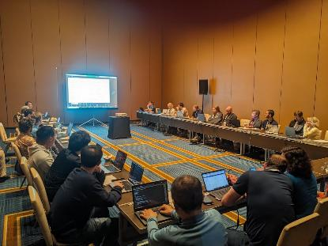


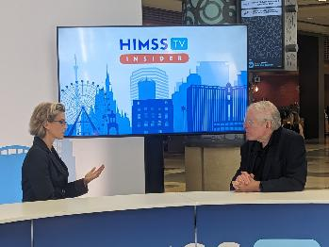
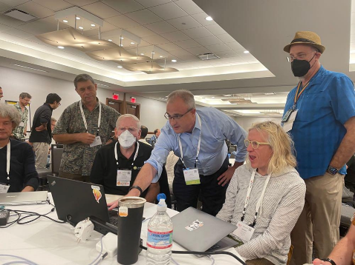

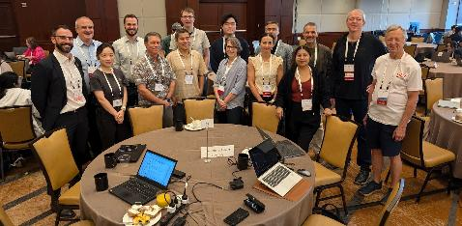
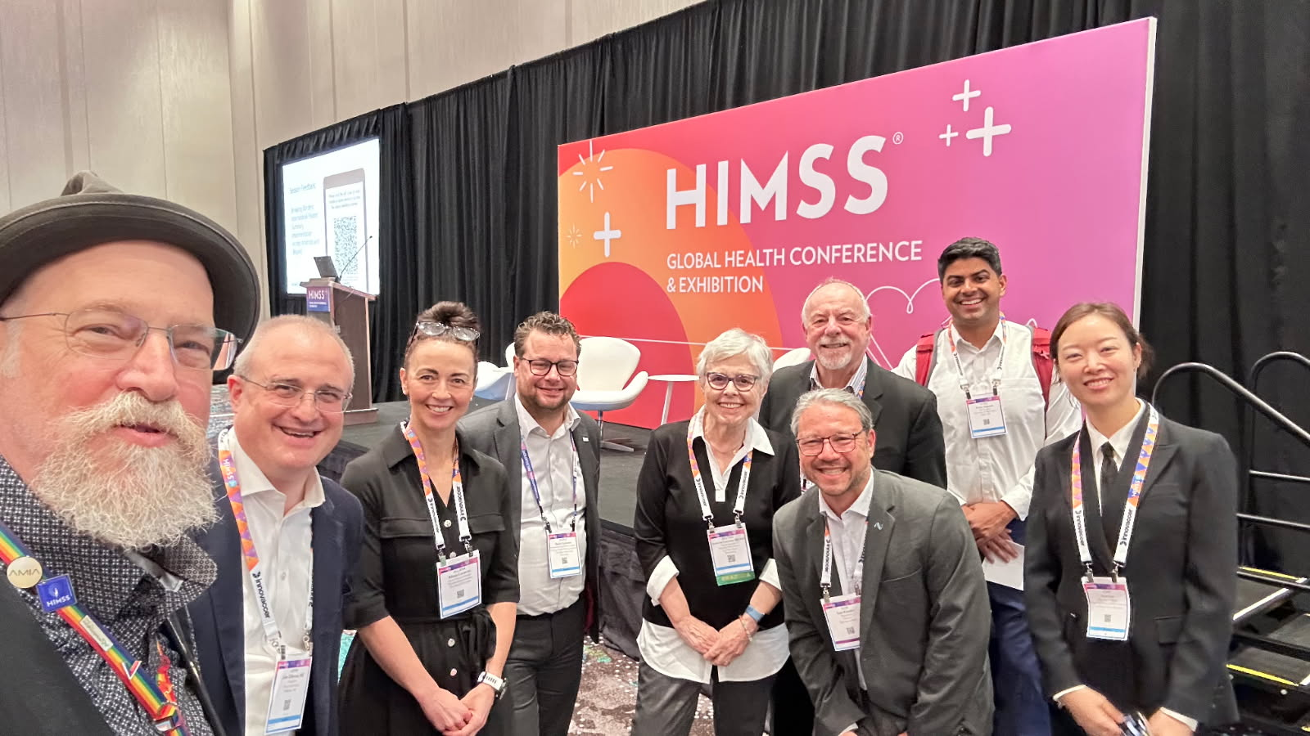
The IPS Community
2016
2022
“Never doubt that a small group of thoughtful, committed citizens can change the world; indeed, it's the only thing that ever has”
2024
2023
2025

Slide 16
How to Get Involved?
Come to an HL7 or IHE Connectathon!
Attend the weekly IPS Project Calls
Join us on https://chat.fhir.org
Attend a working group meeting
Comment on the specification
https://build.fhir.org/ig/HL7/fhir-ips/

Slide 17
Thank You
Questions at end of panelists. But feel free to reach out!
John D’Amore, MS
More Informatics, Inc.
johnd@moreinformatics.com

