Slide 1
IPS Illustrations
This deck aims to hold the most recent versions of commonly used illustrations in IPS presentations and related materials

Slide 4
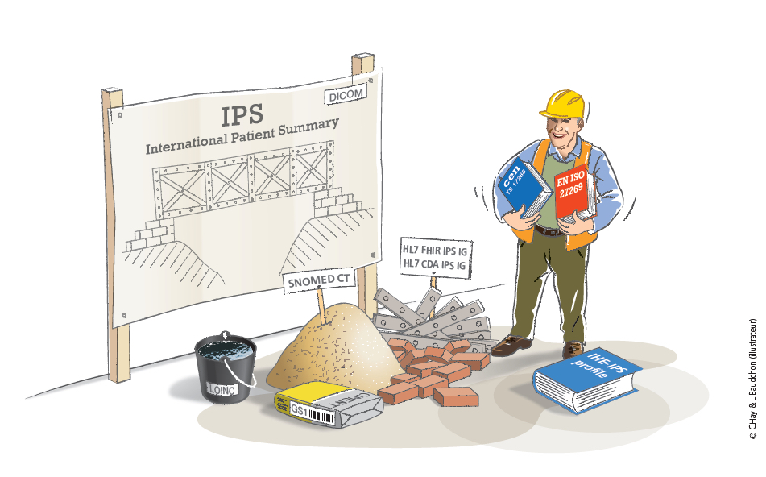

Slide 5
