Slide 1
International Patient Summary
A Global Standard with Local Implementation Requirements
Dr Robert A. Stegwee
Chair, CEN/TC 251 Health Informatics
Co-Lead UNICOM WP 1 – IDMP-related standards and terminologies

Slide 2
Patient Summary in the EHDS*
Priority categories of personal electronic health data for primary use (Article 5)
1. (a) patient summaries
MyHealth@EU – current status
7 EU countries make patient summaries available
9 EU countries enable doctors to retrieve patient summaries
many more in the “pipeline” – will be mandatory as per the EHDS
national scale-up is still an issue in some countries
* EHDS: proposed regulation on the European Health Data Space

Slide 3
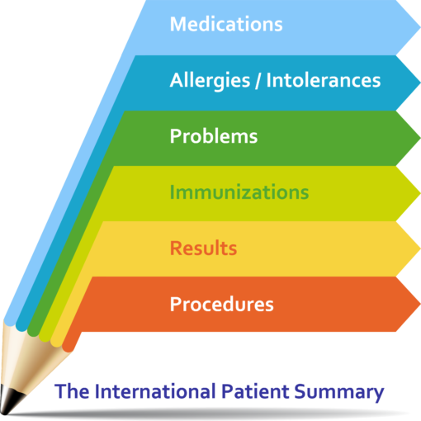
What is a Patient Summary
a health record extract comprising a standardized collection of clinical and contextual information (retrospective, concurrent, prospective) that provides a snapshot in time of a subject of care’s health information and healthcare.
Source: ISO/TR 12773-1:2009 Business requirements for health summary records — Part 1: Requirements https://www.iso.org/standard/51683.html
Notes:
The IPS name comprised of two parts: International and PS
And for starting the process it has been decided to consider a very focused Summary.

Slide 4
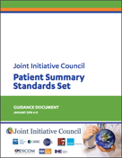
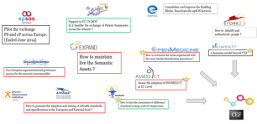
How did the IPS come about?
European Initiatives
2017-2021
2009-2016
2017-2018

Slide 5
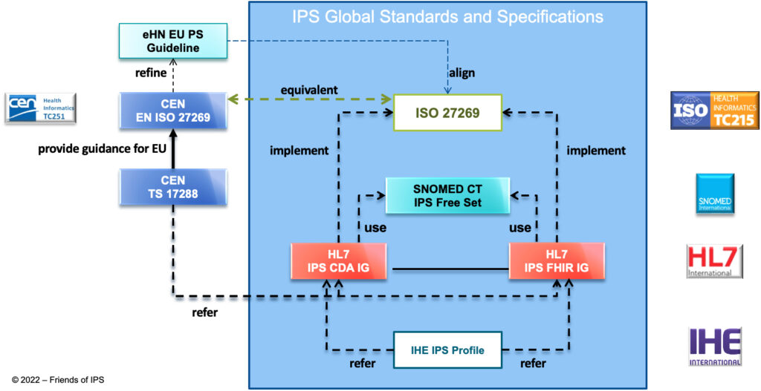
The IPS is not just ONE standard
eHDSI
PS CDA IG

Slide 6
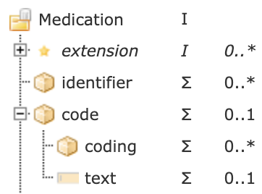
Local implementations – two examples
Canada
Netherlands
The coded medication can be expressed as:
GTIN International Article Number
ZI-nummer (2.16.840.1.113883.2.4.4.8)
Trade product code (HPK)
Prescription code (PRK)
Generic product code (GPK)
Anatomic Therapeutic Classification code (ATC)
Substance Name Code (SNK)
Substance Name Code, in combination with Route of Administration (SSK)
SNOMED CT code

Slide 7
Medication in MyHealth@EU (CDA IG)
The element is used to convey a regional/national medicinal product code or MPID compliant with the IDMP system.
The element MUST NOT be used to convey:
ATC code (see generalizedMaterialKind instead)
PCID code compliant with the IDMP system (containerPackagedMedicine.code to be added later for this use)
The <originalText> under the code MAY be included, but is not expected to be processed by the recipient of the document. If included, it SHALL contain a <reference> whose URI value points to the generic name and strength of the medication in the narrative, or just the generic name alone if strength is not relevant.
If the code is not available, the whole field SHOULD be skipped.

Slide 8
Medication in the IPS

Slide 9
Medication in real life

Slide 10
So who makes the translation?
ePrescribing software modules
Usability and User Experience for clinicians
Medicinal Product Dictionaries
Support ePrescribing with names, codes, dose forms, packages, etc.
Also used by pharmacies for dispensing, invoicing, etc.
National Drug Databases
Provide the details on all authorized medicinal products
Global Drug Databases
Provide linkage based on substance(s), strenght(s) and dose form
A unique global PhPID could be provided and included everywhere

Slide 11
Translations in MyHealth@EU
MyHealth@EU
Master Valueset Catalogue
Master Valueset Catalogue
NCPeH
NCPeH
Dutch local implementation
Belgian local implementation
NL
BE
EHR-S
EHR-S
EHR System
EHR System

Slide 12
Translations for the IPS
Patient requests an IPS
Patient presents an IPS
IPS Preferred Terminology Bindings
IPS Preferred Terminology Bindings
Terminology Server NL
Terminology Server BE
Dutch local implementation
Canadian local implementation
NL
CA
P/EHR System
EHR System

Slide 13
Coordinated development is needed
National/Regional
Implementations
CEN/ISO National Member Bodies
SNOMED National Release Centers
HL7 Affiliates
IHE National Deployment Committees

Slide 14
Questions, Suggestions, Ideas?
https://www.international-patient-summary.net
https://www.youtube.com/@UNICOM-IDMP
https://unicom-project.eu/

