Slide 1
IHE USA’s Path to Production Digital Series
Phase 3 – Defining the Business Case | June 22nd & 23rd, 2022
Advancing the International Patient Summary Through Collaboration
Presented by: Michael Nusbaum, IHE International

Slide 2
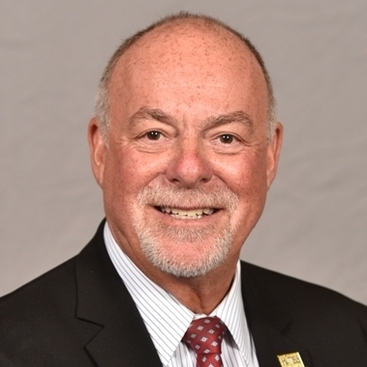
Michael Nusbaum, BASc, MHSA, FHIMSS
  IHE International Board
  ISO/TC215 Health Informatics
  Joint Initiative Council Executive
  IHE IPS Profile xSDO Development co-Chair
  President, MH Nusbaum & Associates Ltd.

Slide 3
Agenda
What is the International Patient Summary (IPS)?
Opportunities afforded by IPS
IPS Collaboration at many levels
IPS Implementation opportunities and learnings
How to engage

Slide 4
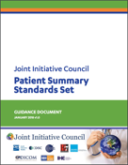
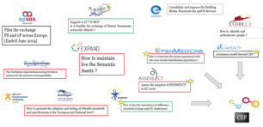

The IPS Journey
European Initiatives
2017-2021
2009-2016
2017-2018
European initiatives

Slide 5
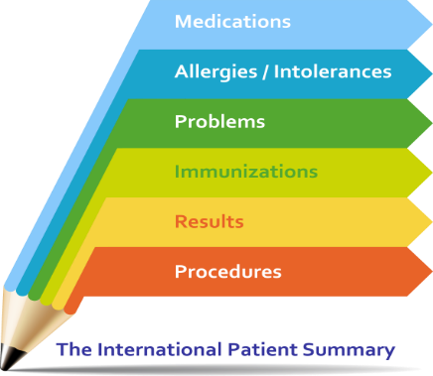
What is the ??
A health record extract comprising a standardized collection of clinical and contextual information that provides a snapshot in time of a subject of care’s health information and healthcare (Patient Summary)
Provides a generic solution for global application beyond a particular region or country (International)
It is minimal and non-exhaustive
It is specialty-agnostic and condition-independent……but still clinically relevant
A “document” (persistent set of data) composed of re-usable profiles

Slide 6
IPS Content

Slide 7
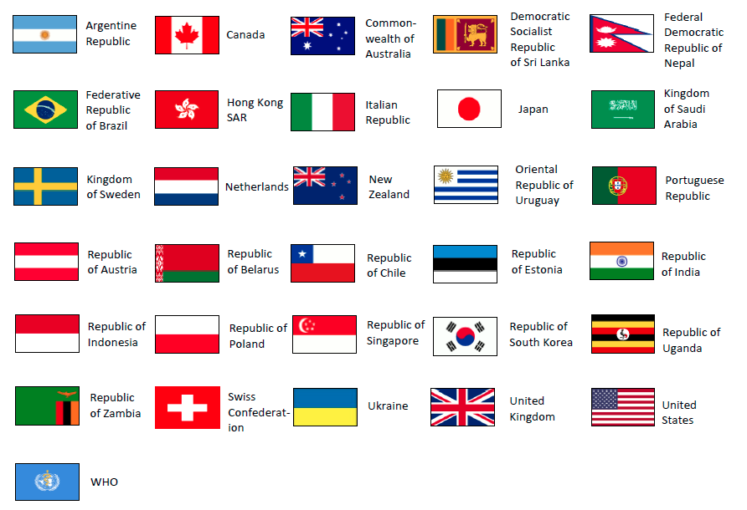
Opportunities Afforded by IPS
Considered a vital component of digital health
International in scope, resulting in international engagement
Use cases: local, regional, national and international
Fostered collaboration at the outset; collaboration continues to increase!
Unprecedented international support:
  G7 Commitment (June 2021)
  Global Digital Health Partnership (GDHP)
  Many implementations underway
“Commitment to working towards adopting a standardised minimum health dataset for patients’ health information, including through the International Patient Summary (IPS)
Standard”

Slide 8

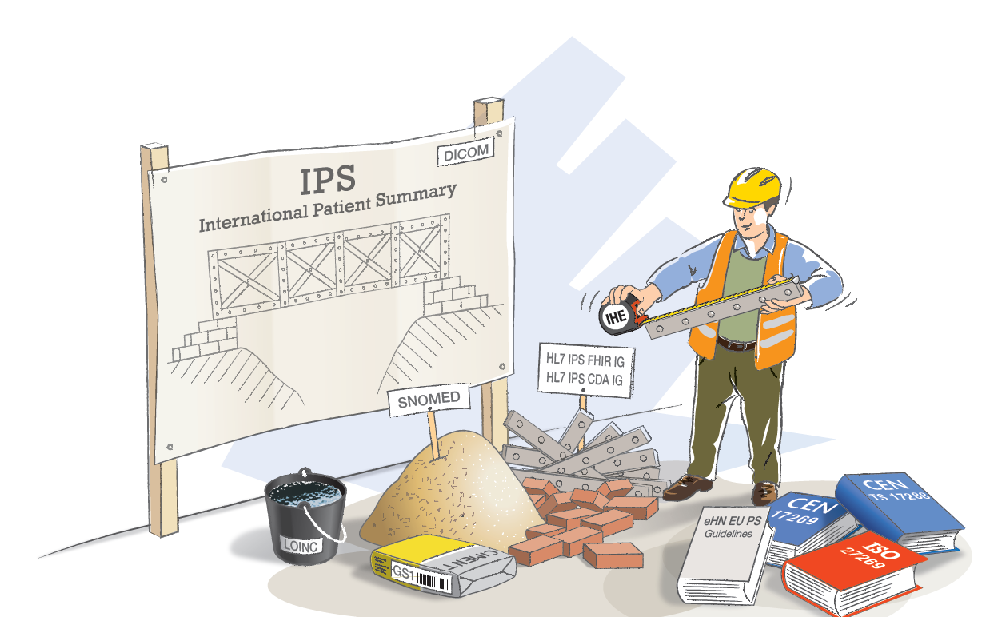


SDO Collaboration
New & unprecedented
Rich set of standards artifacts, designed to be complementary
Continued synchronization:
  Maintenance
  Managed growth
Realized value:
  Clarity for the “customer”
  Reduced overlap /competition
  Leverages expertise from all

Slide 9

xSDO IPS Governance
Provided by the Joint Initiative Council (JIC)
A JIC “special committee” for IPS… others may follow
Ongoing collaboration
Processes to address synchronized maintenance & dependencies
Processes to add additional function
Balloting and Publication not synchronized (lesson learned)
www.jointinitiativecouncil.org

Slide 10
Collaboration with Implementers
Feedback from testing: Connectathons (IHE, FHIR, GDHP)
At scale implementer feedback considered essential to maintain the quality of the standards artifacts
Feedback loops provided to JIC xSDO IPS Collaboration Committee, and to individual SDO’s
Support from industry associations (HIMSS, GDHP, vendor groups)
Implementer feedback reflected in new releases of all artifacts

Slide 11
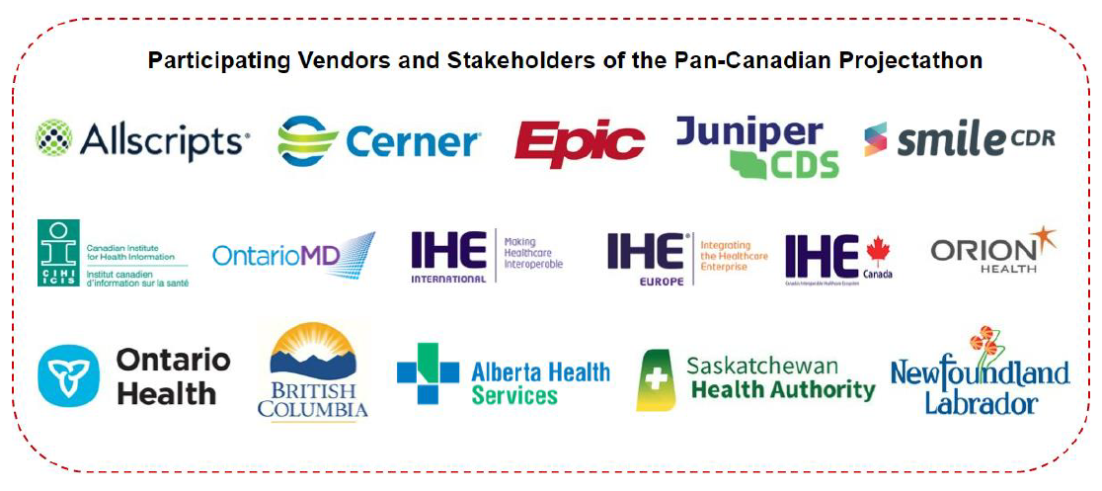
Canada’s Implementation of IPS
The first pan-Canadian Projectathon
Testing a pan-Canadian specification for Patient Summaries (PS-CA), built on the (IPS) standard
Utilization of IHE process, IHE tooling (Gazelle) and IHE Support (IHE Catalyst)
Feedback to the SDO’s:
Need to add support of Provenance
Problems with unique identification of documents
FHIR-based integrations are still primitive, one-off, and point-to-point
Curation of Patient Summaries for different specialist groups
Workflow: how to keep the data in Patient Summaries relevant, organized and updated for clinicians to facilitate transitions of care
Canada feedback: ISO; HL7; IHE; SNOMED; JIC

Slide 12
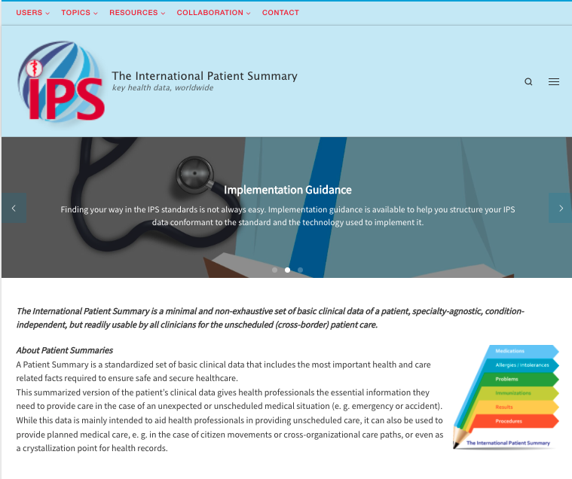
IPS Website
Single-source, logo, motto “key health data worldwide”
Navigation guidance for different audiences
  Patient, Healthcare Provider
  Health Data Expert, IT Developer, Standards Expert
Implementation Guidance
Standards & Specifications
Educational Materials
Global Implementation References
Community of Practice
Publications, Presentations, Videos (including a “vault”)
IPS Viewer (open source)
https://international-patient-summary.net/

Slide 13

Further Information
Contact:
Michael Nusbaum
michael@mhnusbaum.com
+1-786-603-9137

