Slide 1
Global Forum 2022
The International Patient Summary
Christian Hay, Senior Consultant Healthcare, GS1 GO
Neil Piper, Senior Manager AIDC, GS1 GO
Jo Gouding, Senior Engagement Manager Healthcare, GS1 UK
Sophie Molle, Senior Manager Healthcare, GS1 GO
Wednesday 23rd of February 2022
This session is being recorded for viewing by Global Forum registrants only.

Slide 2
GS1 Competition Law Caution
GS1 operates under the GS1 Competition Law Caution. Strict compliance with competition laws is and always has been the policy of GS1.
The best way to avoid problems is to remember that the purpose of the group is to enhance the ability of all industry members to compete more efficiently.
This means:
  There shall be no discussion of prices, allocation of customers, or products, boycotts, refusals to deal, or market share
  If any participant believes the group is drifting toward impermissible discussion, the topic shall be tabled until the opinion of counsel can be obtained.
The full caution is available via the link below, if you would like to read it in its entirety: http://www.gs1.org/gs1-competition-law-caution

Slide 3
Meeting etiquette
Be present
Presenters turn on video
Avoid multitasking
Be considerate
Mute microphone
Keep comments concise
Be collaborative
Ask questions
Be open to other views
Represent
Speak on company’s behalf

Slide 4
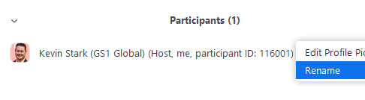


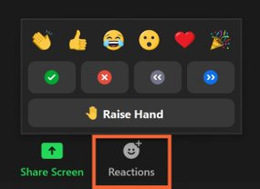
Ways to improve your Zoom experience
In the “Participants” list on the right side of the Zoom window, hover over your name, click “More” and click “Rename”
Change your screen name
Click the Chat button in the bar at
the bottom of your screen to open
the chat window
In the bottom menu bar,
Click the Reactions button to access
emojis and to raise your hand during Q&A

Slide 5
Our programme
# Duration | Headline | Comment
1 20’ | Introduction (usual rules) Who is who Goals of this workshop | We want to collect information for one or more trainings Mentimeter used extensively, anonymous Ask questions in the Q&A on the fly
2 20’ | Overview IPS Example from Wales | Mentimeter Session
3 20’ | Break-out session | 18 minutes movie: https://youtu.be/1VKt2LysGxA (quality to be improved)
4 20’ | Deep dive ISO-HL7 | Mentimeter Session
5 10’ | Deep dive SNOMED | Mentimeter Session
6 20’ | Deep dive IHE | Mentimeter Session
7 10’ | Wrap up | Mentimeter Session

Slide 6
Introduction

Slide 7

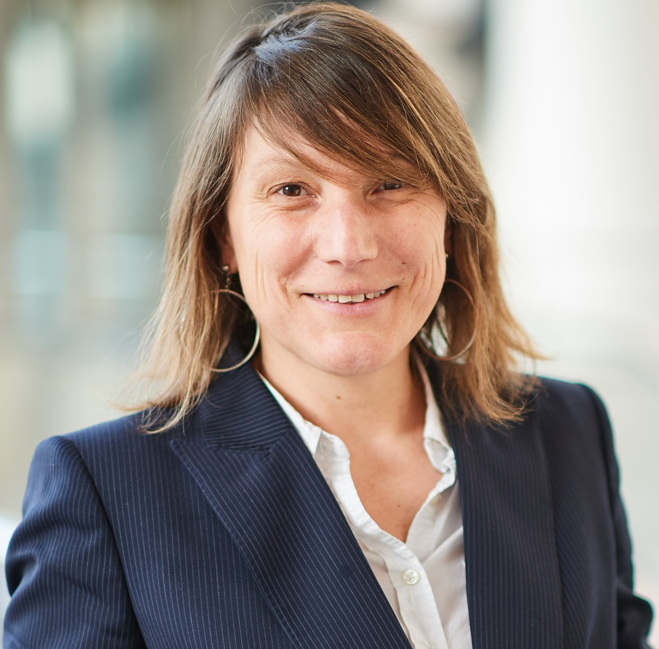
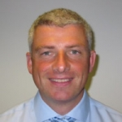

Today’s team: meeting… YOU !

Slide 8
Our goal today
Provide an overview about health information technology standards
By using the «International Patient Summary» as an example
Interactivity by using Mentimeter (entries are anonymous)
Collecting material from YOU for the development of one or more training materials

Slide 9
Our vision today: the five ‘C’ of digital health standards
1. Care guidelines
2. Specifications related to Content
3. Coding
4. Communication
5. and Confidentiality

Slide 10

Our interactive session:
Everybody is on mute
You post your question in the Chat facility
When you speak, please keep concise
You may show your approval !
After (and during) the introduction presentations,
any question / comment may be shared with the chatbox

Slide 11
Overview IPS

Slide 12
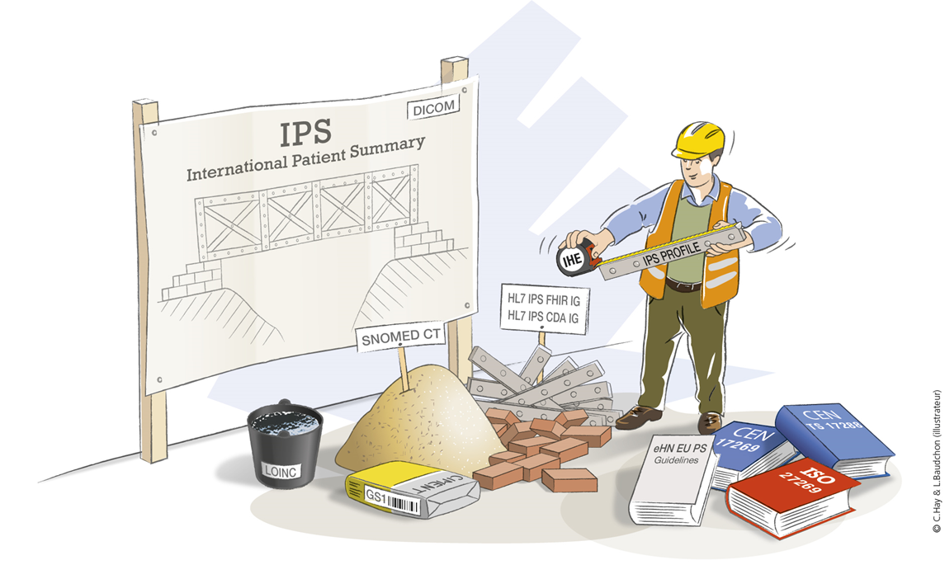
International Patient Summary
The International Patient Summary (IPS) is building the bridge between the “home” health and care environment of the patient and any other place where the patient needs to visit a clinical professional, whether within or across borders.
The construction of the IPS involves a number of standard components and bespoke specifications to make it all work together. This includes CEN and ISO, as well as HL7 standards.
To enable the use of the same coded entries for patient summary sections such as allergies, problems, procedures, and immunizations, SNOMED International makes available the IPS subset of SNOMED CT, under a free creative commons license. In the future, similar subsets may be published by LOINC for diagnostic tests, by DICOM for medical images and by GS1 for medical device or medicinal product identification data to be included in the patient summary. IHE plays an interesting role as well.

Slide 13
IPS in a global context
The International Patient Summary is the latest joint activity within JIC and includes most of the JIC participating standard development organisations. It has a global scope -on a clinical and geographical point of view.
It has been endorsed by several public bodies…
Recognised by G7 at its Oxford (UK) June 2021 meeting.
Global Digital Health Partnership (GDHP) to advance efforts to make IPS reality.
Although without formal endorsement, WHO Digital Health and Innovation team members have participated to some IPS related works such as FHIR Connectathon.

Slide 14
Global Digital Health Partnership (GDHP) & IPS
Evidence & Evaluation
Clinical & Consumer Engagement
Interoperability
Cyber Security
Policy Environments
GDHP Work Streams
IPS Work Group
GDHP Overview
Purpose: Established in 2018 to support the effective implementation of digital health, exchange global best practices, and advance mutually beneficial projects.
Members: 36 (national governments, WHO, OECD, and I-DAIR)
Vision: “Support governments and health system reformers to improve the health and well-being of their citizens through the best use of evidence-based digital technologies.”
Chair: India
Vice-Chair: United States of America
GDHP Interoperability Work Stream’s IPS Efforts
Mini-Connectathons to Pilot the Standard
Members’ Presentations on their Local Infrastructures and IPS
Terminology Issues
Patient-Mediated Exchange Consensus for IPS
IPS Use Cases
Work Group Goals Consensus

Slide 15
Some characteristics of the IPS
(Proof of Concept Wales)
Patient mediated dossier with health data (medical record)
  Subject of Care see history and add personal information
  Subject of Care decide to share medical record
  Subject of care access measurements
  Subject of care access supporting information from local care organisation
Secure access
IPS creation (by Subject of Care) and enrichment (by Subject of Care and professionals)
IPS consumption (by professionals)
Visit another healthcare professional / travel

Slide 16
IPS – Proof of concept Wales
12 minutes video presenting the Wales PoC: https://youtu.be/zpPlZNSvSB0
Several countries initiate IPS implementation
But…. Answers from the JIC webinar 9 December 2021

Slide 17
Bio-break

Slide 18
Educational movie for your break!

Slide 19
ISO – HL7

Slide 20
Role of CEN/ISO and HL7 regarding IPS
CEN (European Committee for Standardisation) and ISO (International Organization for Standardisation) provide the conceptual model and its implementation guide (that includes part of the logical model)
HL7 provides the logical and physical models

Slide 21
Role of CEN/ISO and HL7 regarding IPS
What data means
Defined concepts and relationships that are used in the real world / universe of discourse
Example: “Patient Identifier: unique value that identifies a single patient or subject of care”
Conceptual Model
(concepts and relationships)
EN/ISO 27269
CEN ISO TS 17288
Represented as
How data is modelled
Structures for how data is modelled, with data elements, groups, relations, cardinality, data types, etc.
Example: Patient.PatientID: 0..1: string
Logical Model
(data elements and relations)
Implemented as
How data is implemented
An actual implementation in a physical system, e.g. a database or a field in a file
Examples: “Patient_ID: VARCHAR(25)”
Physical
(technical specification)
CEN: European Committee for Standardisation; ISO : International Organisation for Standardisation

Slide 22
ISO 27269 defines the identifiable core IPS dataset “essential and understandable”
Patient attributes
Allergies & intolerances
Problems (incl. diagnosis)
Medication summary
Immunization (incl. Vaccinations)
Results
Vital signs
IPS Datablocks
Healthcare provider
History of procedures
History of past illness/ problems
History of pregnancy
Medical devices (incl. implants)
Functional status
Social history (incl. life style factors)
Address-book
Advance directives
Care plan
Child-health
Family history (incl. Genetics)
Recent encounters
Computable guidelines (incl. Orthacodes)
Provenance
Alerts (incl. Risks)
Patient story
(incl. Author)
IPS required
Richer IPS
Cross-border (conditional)
…
Candidate IPS

Slide 23
ISO 27269 defines the identifiable core IPS dataset “essential and understandable”
Patient attributes
Allergies & intolerances
Problems (incl. diagnosis)
Medication summary
Immunization (incl. Vaccinations)
Results
Vital signs
IPS Datablocks
Healthcare provider
History of procedures
History of past illness/ problems
History of pregnancy
Medical devices (incl. implants)
Functional status
Social history (incl. life style factors)
Address-book
Advance directives
Care plan
Child-health
Family history (incl. Genetics)
Recent encounters
Computable guidelines (incl. Orthacodes)
Provenance
Alerts (incl. Risks)
Patient story
(incl. Author)
IPS required
Richer IPS
Cross-border (conditional)
…
Candidate IPS

Slide 24
ISO 27269 defines the identifiable core IPS dataset “essential and understandable”
Patient attributes
Allergies & intolerances
Problems (incl. diagnosis)
Medication summary
Immunization (incl. Vaccinations)
Results
Vital signs
IPS Datablocks
Healthcare provider
History of procedures
History of past illness/ problems
History of pregnancy
Medical devices (incl. implants)
Functional status
Social history (incl. life style factors)
Address-book
Advance directives
Care plan
Child-health
Family history (incl. Genetics)
Recent encounters
Computable guidelines (incl. Orthacodes)
Provenance
Alerts (incl. Risks)
Patient story
(incl. Author)
IPS required
Richer IPS
Cross-border (conditional)
…
Candidate IPS

Slide 25
Role of CEN/ISO and HL7 regarding IPS
What data means
Defined concepts and relationships that are used in the real world / universe of discourse
Example: “Patient Identifier: unique value that identifies a single patient or subject of care”
Conceptual Model
(concepts and relationships)
EN/ISO 27269
CEN/TS 17288
Represented as
How data is modelled
Structures for how data is modelled, with data elements, groups, relations, cardinality, data types, etc.
Example: Patient.PatientID: 0..1: string
Logical Model
(data elements and relations)
Implemented as
HL7 CDA IPS IG
HL7 FHIR IPS IG
How data is implemented
An actual implementation in a physical system, e.g. a database or a field in a file
Examples: “Patient_ID: VARCHAR(25)”
Physical
(technical specification)
CEN: European Committee for Standardisation; ISO : International Organisation for Standardisation

Slide 26
HL7 CDA IPS IG - HL7 FHIR IPS IG
FHIR is the most recent primary standard developed by Health Level 7 (HL7) and based on internet standards for data exchange used by many industries. FHIR breaks down information into packets, called resources within the standard, which can be communicated through application programming interfaces, often in the form of requests and responses.
The HL7 Version 3 Clinical Document Architecture (CDA) is a document markup standard that specifies the structure and semantics of "clinical documents" for the purpose of exchange between healthcare providers and patients
A CDA can contain any type of clinical content such as Discharge Summary, Imaging Report, Referral, Prescription. The most popular use is for inter-enterprise information exchange

Slide 27
SNOMED CT

Slide 28
SNOMED CT
A controlled coded clinical terminology for use in Electronic Health Records
SNOMED International are committed to maintaining and growing SNOMED CT, ensuring it is accepted and used as the global common language for clinical terms
SNOMED CT provides a solution for making electronic health records meaningful

Slide 29
IPS sub-ontology
In 2019 SNOMED International and HL7 International announced formalisation of a ‘Free for Use’ set of SNOMED CT coded concepts within IPS
The IPS Freeset is a richer dataset than the current Global Patient Set (GPS)
The GPS supports transfer of information across borders into countries not licensed to use SNOMED CT. Containing code, description and status flag
The IPS Freeset however is a sub ontology and therefore also provides properties and relationships
SNOMED International have committed to delivery of the IPS Freeset in 2022
312342009 Infective pneumonia
75570004 Viral pneumonia

Slide 30
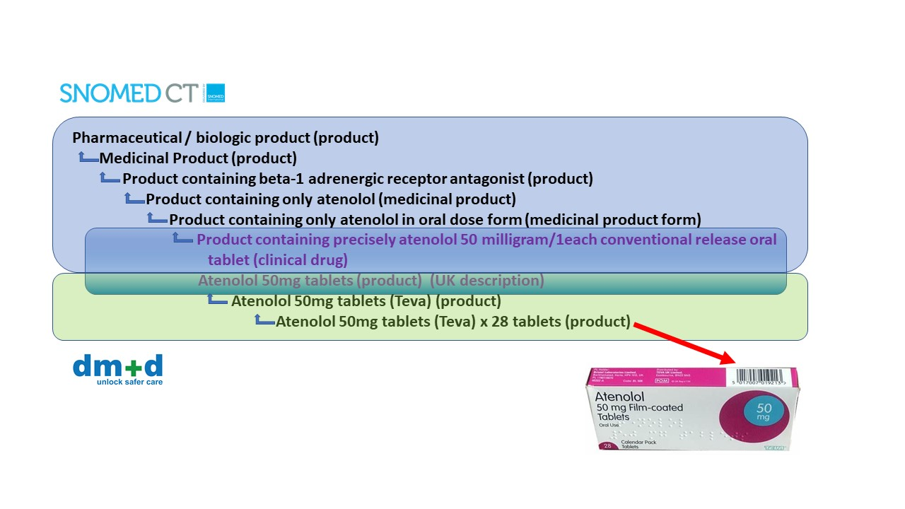
SNOMED CT - Medicines

Slide 31
IHE

Slide 32
Integrating the Healthcare Enterprise (IHE)
IHE is an initiative by healthcare professionals and industry to improve the way computer systems in healthcare share information.

Slide 33
IHE process
Stakeholders define their needs in a White Paper
Stakeholders define Interoperability Use Cases
Break down in Technical Use Cases
Use of existing standards
Description of IHE Profiles
Interoperability Specifications for Use Case
Interoperability Testing (IHE Connectathon)
  Testing results published to be used in call for tenders

Slide 34
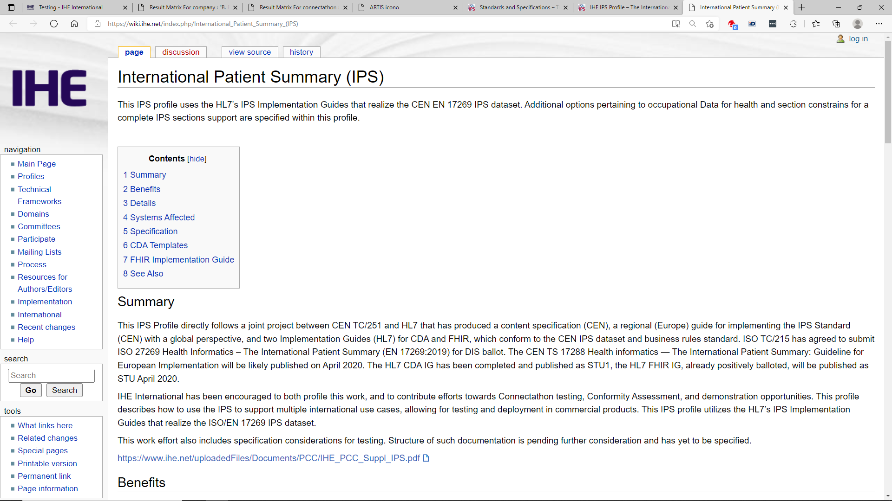
IHE IPS Profile
IHE IPS profile developed to support testing between content creator and content consumer
Underlilying standards:
  HL7 CDA® R2 Implementation Guide International Patient Summary STU Release 1
  EN/ISO 27269 Health informatics — The international patient summary
  SNOMED International
  Unified Codes for Units of Measures, Regenstrief Institute, Inc. and the UCUM Organization
  Anatomical Therapeutic Chemical (ATC) classification system World Health Organization (WHO) Collaborating Centre for Drug Statistics Methodology
  European Directorate for the Quality of Medicines (EDQM)
  International Standard Classification of Occupations

Slide 35
Wrap-up

Slide 36
Importance of SDO collaboration

Slide 37

GS1 Healthcare Reference Book 2022/23
Abstract submission period:
25 January - 24 February 2022 (23:59 CET)
Summary of your work only
Case studies submission period:
10 March – 29 April 2022 (23:59 CET)
Selected cases will be included in
the 2022-2023 Reference Book

Slide 38
THANK YOU FOR YOUR PARTICIPATION!

Slide 39



Did you enjoy the session?
Please complete the session survey
Each day you receive a daily summary email from globalforum@gs1.org :
Click the survey link in the email
Rate the sessions that you attended
In appreciation of your time, we’ll donate 5 € to UNICEF for water pumps,
water purification tablets and soap.
Notes:
UNICEF
UNICEF works in over 190 countries and territories to save children's lives, to defend their rights, and to help them fulfil their potential, from early childhood through adolescence.
Cold box vaccine carrier
Thanks to the cold box vaccine carrier, the cold chain for vaccines can be respected.
The carrier makes sure vaccines are quickly distributed to children at the required temperature in the most remote areas.
Polio vaccine, tetanus vaccine and measle vaccine
Vaccination and immunization are part of UNICEF’s priorities.
Through the vaccines, children are protected from these preventable diseases and have a better chance in life.

Slide 40


Join the conversation on Twitter or LinkedIn
#GS1GlobalForum2022

Slide 41
Contact information
Christian Hay
Senior Consultant Healthcare
Christian.hay@gs1.org
Sophie Molle
Senior Manager Healthcare
Sophie.molle@gs1.org
Neil Piper
Senior Manager AIDC
Neil.piper@gs1.org
Jo Goulding
Senior Engagement Manager Healthcare
Jo.Goulding@gs1uk.org

Slide 42



Still have questions?
Reach out anytime to the GS1 Customer Service Portal or email the GS1 Help Desk:
https://support.gs1.org
helpdesk@gs1.org
Notes:
If you still have questions after Global Forum, you can get in touch with us by using the new Customer Service Portal or by sending an email to the Help Desk. Using these helps us improve our training and support materials. Your questions will be tracked and promptly answered after Global Forum.

